Slide 1
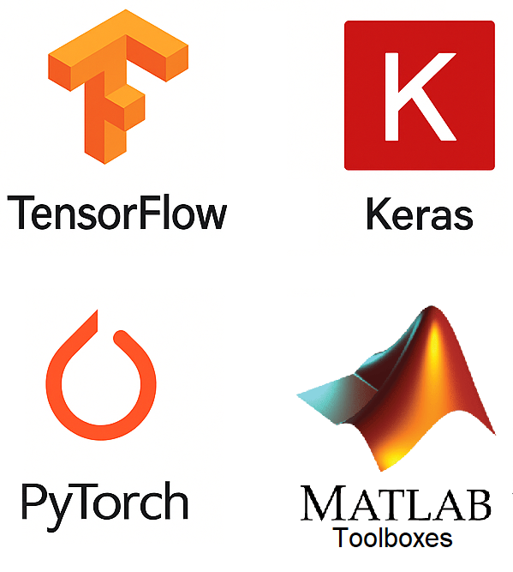
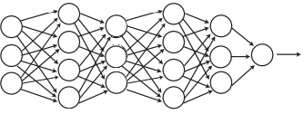
Deep Learning With Python
Classification problem
Deep Learning frameworks (libraries)
Data
Predctions
Loss
Model
Weight update
We use these
Model
____________________________________________
We focus on this part
Loss
(Binary) Cross Entropy
Weights update
Gradient descent

Slide 2




Neural Network
Building Block: Artificial neuron
Classification problem
x$_{1}$
x$_{2}$
.
.
.
.
.
.
x$_{n}$
$$w_{i}$$
Data
Predctions
Loss
Model
Weight update
$$σ(w·x+b)$$
Output
Model
We focus on this part
Deep Network
Loss
(Binary) Cross Entropy
Input
Output
Weights update
Gradient descent
Feed Forward

Slide 3







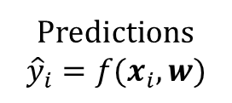
Classification problem
(Binary - Recap)
CAT
[0]
DOG
[1]
Data
Predictions
Loss
Loss Function computing
Measure of Error
Model
Weight update
$$D=(x_{i},y_{i})$$
x input
y label
Idetify the class
(Desired output)
L =
$$−log P\left(D | w\right)=$$
$$∑_{i}−y_{i}log ({\hat{y}}_{i} ) − (1 −y_{i}) log (1 −{\hat{y}}_{i})$$
Predictions
$${\hat{y}}_{i}=f(x_{i},w)$$
$$f(·,w)$$
Weights update $w$
(Loss function minimized)
Model
w parameters
New predictions computed
Results of the training process
$$f(·,w^{final})$$

Slide 4
Deep Learning Frameworks
Deep learning frameworks are software libraries that make it easier to design, build, train, and deploy deep learning models, especially neural networks.
Instead of starting from scratch and writing low-level code to handle things like matrix operations or GPU acceleration, these frameworks provide ready-made tools.
They help in:
Building models layer by layer (e.g., feedforward, convolutional or recurrent)
Training models efficiently using CPUs or GPUs
Visualizing progress (e.g., accuracy and loss over time)
Saving and deploying trained models to web apps, mobile devices, or servers
Different frameworks have different strengths. Some are great for beginners, while others offer more control and flexibility for research or large-scale applications.

Slide 5
Deep Learning Frameworks
Python Libraries
Can model Complex architectures
Not so easy to use
Quite Flexible
Easy visualization tools
Most popular in the Industry
High-Level API (it is a TF interface)
Basic architectures
Very easy to use
Limited Flexibility
Best choice for newbies
Can model Complex architectures
Not so easy to use
Very Flexible
Needs more lines of code
Most popular in Academia
Not a proper DLF
Not free (needs license)
Specialized toolboxes
Quite easy to use
Limited Flexibility
PyTorch vs TensorFlow vs Keras

Slide 6
Deep Learning Frameworks
Tensorflow – Keras
Keras is API for Tensorflow:
An API (Application Programming Interface) is a set of tools that allows two pieces of software to communicate with each other.
It provides a set of easy-to-use commands (functions, classes, tools)
You don’t need to understand all the complex math or hardware underneath
You just call the functions, give them your data, and they do the work
You can see it is like a bridge that connects different programs (your Python script vs deep learning framework Tensorflow), allowing them to exchange information and functionality without having to share source code.

Slide 7
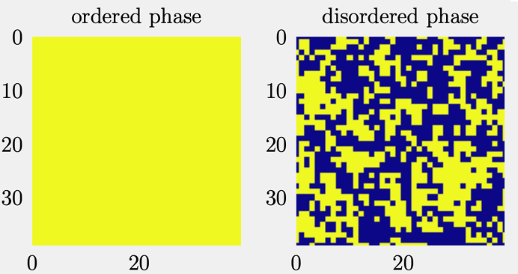




Task to be solved:
Identifying the phases of the 2D Ising model
Logistic regression as 1 Neuron network
x$_{1}$
x$_{2}$
.
.
.
.
.
.
.
x$_{n}$
$$θ_{i}$$
$$σ(θ·x+b)$$
Output
Poor performance
Can we improve? Cybenko universal approximation theorem 1989

Slide 8






Task to be solved:
Identifying the phases of the 2D Ising model
Network with 1 hidden layer
x$_{1}$
$$θ_{ij}^{1}$$
x$_{2}$
.
.
.
.
.
.
.
x$_{n}$
$$σ(θ_{1}^{1}·x+b_{11})$$
$$θ_{1}^{2}$$
$$σ(θ^{2}·a+b_{2})$$
Output
$$θ_{2}^{2}$$
$$σ(θ_{2}^{1}·x+b_{12})$$
Poor performance
Hard task to build ‘by hand’ the gradients, even for a small network – Keras can help us !!!

Slide 9
How to improve performances?
MORE LAYERS
More model expressivity
How to build gradients ‘by hand’ here?
I think impossible (in adequate times)!
Deep_Dense_ising.ipynb – Colab
Code for this network

Slide 10
We will
Build the three models we discussed (using Keras) (Deep learning Framework)
Take our first look at Google Colab (Start with Colab) (Computational resources offered by Google)
Run Python in notebooks (Way to run python interactively)
Have our first interaction with GitHub (repositories “folders” to store and share code)
All the material is loaded in this folder.
The main useful files are:
_FCA_DeepNeuralNework with TensorFlow_lezione.pptx
Deep_Dense_MNIST.ipynb
Deep_Convolutional_MNIST.ipynb

Slide 11
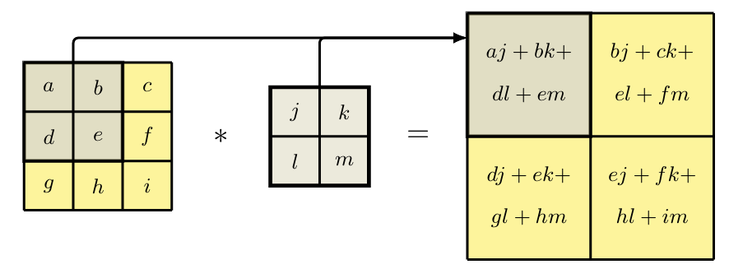
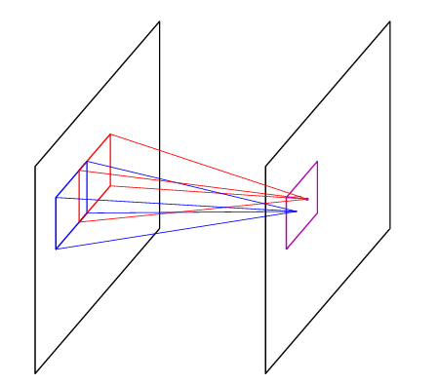
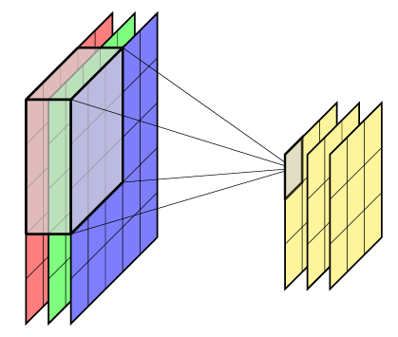
Book
Deep Learning, Bishop 2024
Kernel
(weights)
Input
(or previous layer)
Output
(convolution)
We can adjust (set) these parameters
Kernel size
Number of kernels (maps)
Activaction function
Input
Output
Fully
Connected Layer
Convolutional Layer

Slide 12
Data
Predictions
Loss
Model
Weight update
Model
Fully
Connected Layer
Fully
Connected Layer
Convolutional Layer
Convolutional Layer
Local connectivity (receptive fields)
Each unit is connected only to a local region of the input
(Assumes nearby elements (ex. pixels) are more related)
Parameter sharing (filters/kernels)
The same weights are reused → fewer parameters
Translation “invariant”
When shifting input (e.g., moving an object in an image)
patterns can still be detected
Hierarchical feature learning
Early layers detect simple features (an eye in an image)
Deep layers detect complex patterns (an entire person)
Much fewer parameters than fully connected layers
Global connectivity
Every unit is connected to all ones in the previous layer
No structure assumptions
The model does not assume local relationships of inputs
Sensitive to input ordering
Changing the order of input features changes the result
Feature learning is global
Each neuron mixes information from the entire input
Large number of parameters
Poor with high-dimensional inputs (e.g., images)

Slide 13
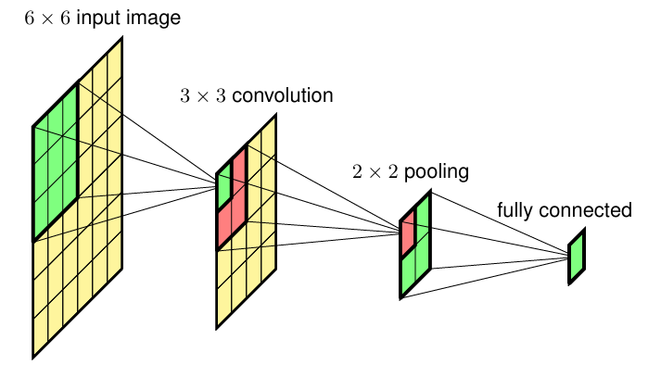
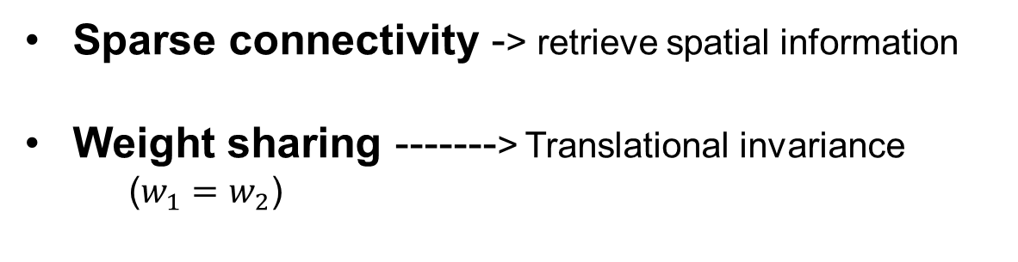

Convolutional Neural Netowrks
(CNNs)
We can adjust (set) these parameters
Kernel size
Number of kernels (maps)
Activaction function
$$w$$
Sparse connectivity -> retrieve spatial information
Weight sharing -------> Translational invariance
($w_{1}=w_{2}$)
Book
Deep Learning, Bishop, 2024

